Slide 1
The Excretory System & Urinary System
The Waste Removal System

Slide 2
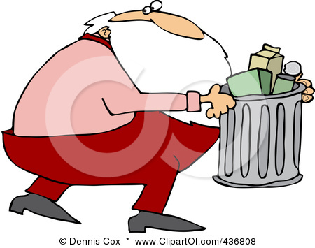
The Excretory System
Function – to remove waste products from the body

Slide 3
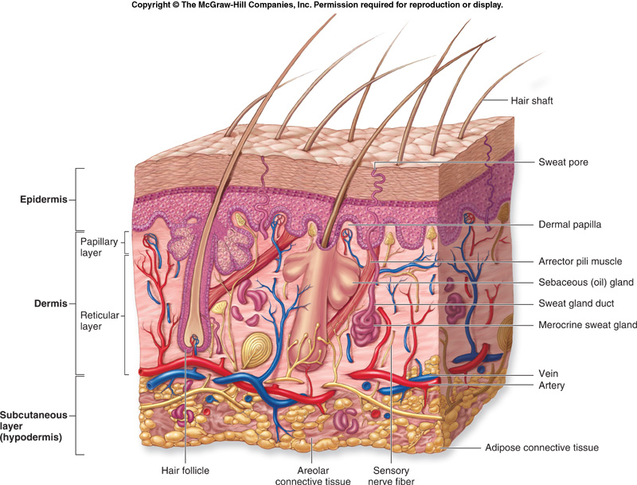
The Excretory System
Components
Integumentary System (skin) – releases sweat which removes excess water, sugar and urea

Slide 4
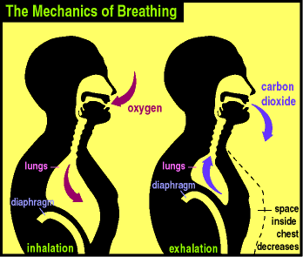
The Excretory System
Components
Integumentary System
Respiratory System – eliminates waste gases such as carbon dioxide

Slide 5
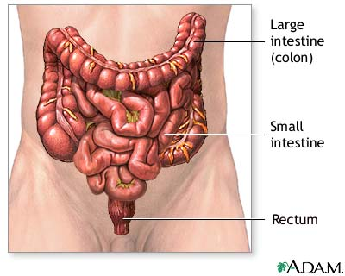
The Excretory System
Components
Integumentary System
Respiratory System
Digestive System – eliminates solid waste and the liver breaks down some waste products to be excreted

Slide 6
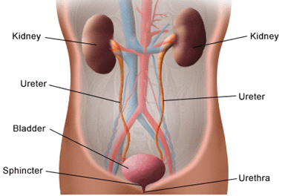
The Excretory System
Components
Integumentary System
Respiratory System
Digestive System
Urinary System – filter excess water, urea, salt and other waste products from the blood

Slide 7
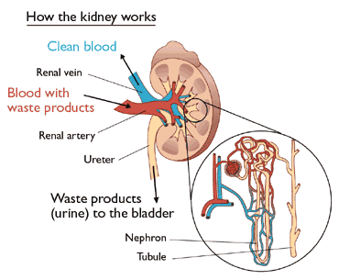
The Urinary System
Kidneys
Nephron – tiny structures in the kidneys that filter the blood and remove excess water, salt, urea and other waste products from the blood
Urea – chemical that results from the breakdown of proteins
Each kidney contains
about 1 million nephrons
The liquid that remains in
the kidney after filtering
is called urine

Slide 8
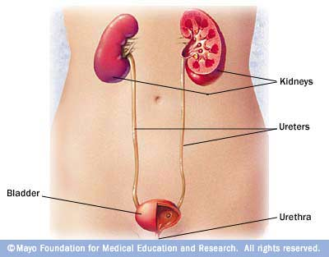
The Urinary System
Ureter – tube that carries urine from the kidney to the bladder for storage
Bladder – where urine
is stored until ready to
be voided from the body
Urethra – tube that
carries urine from the
bladder to outside the
body
http://www.youtube.com/watch?v=aQZaNXNroVY

